Slide 1
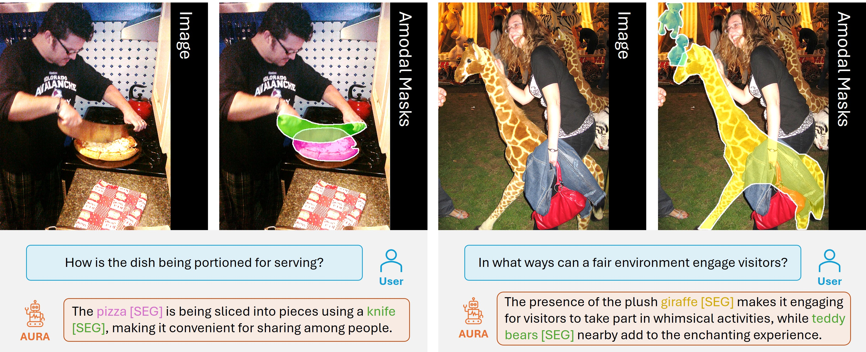

Slide 2
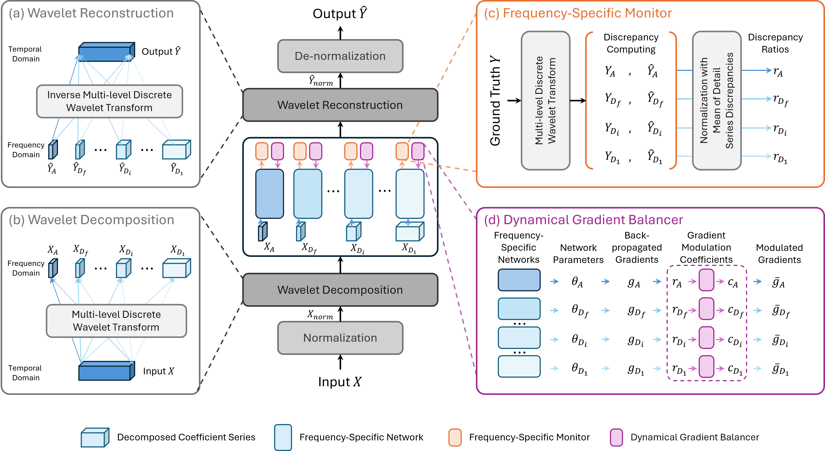

Slide 3
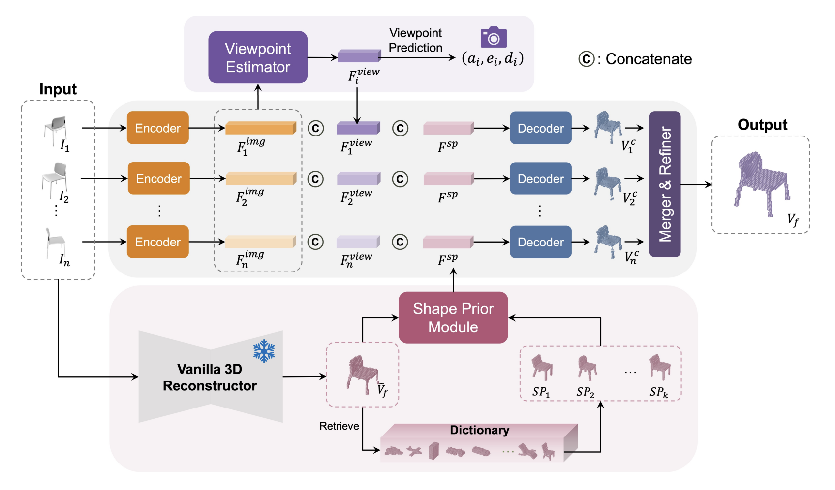
Notes:
2024 ACCV VIPNet

Slide 4
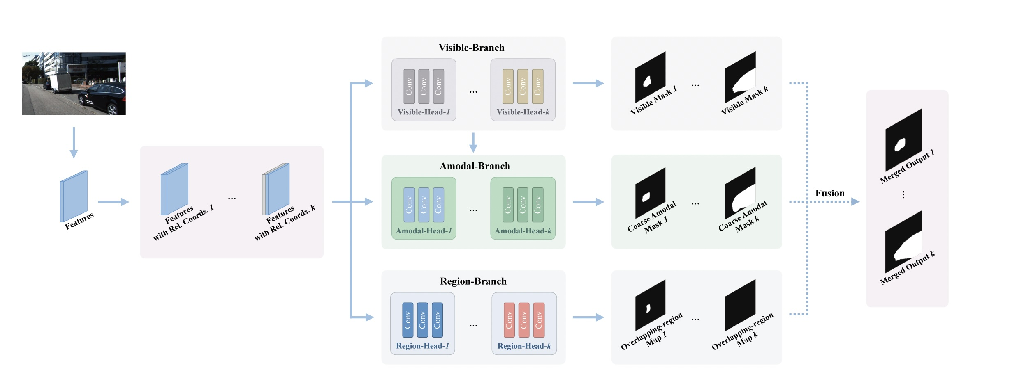

Slide 5
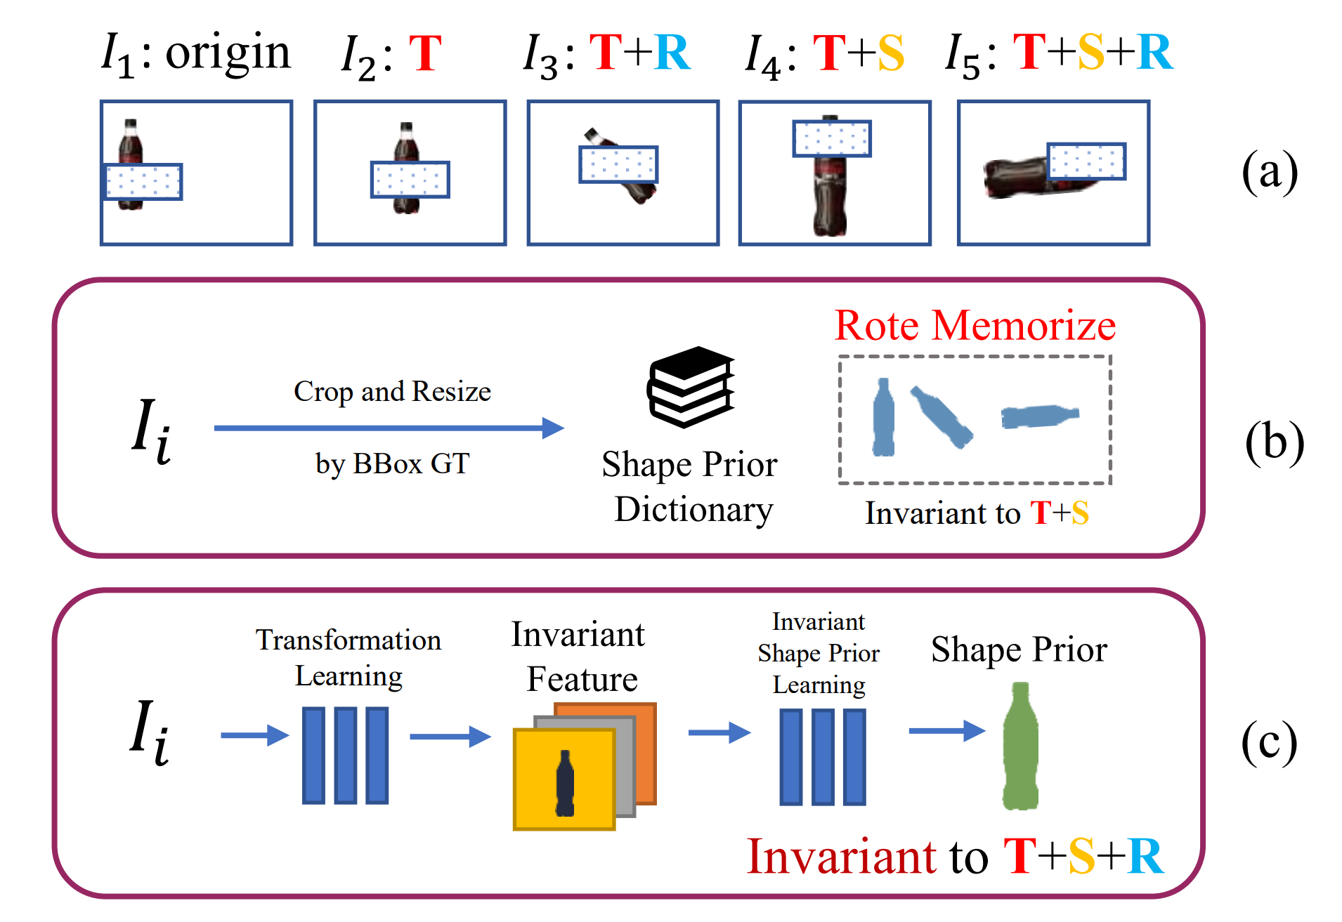

Slide 6
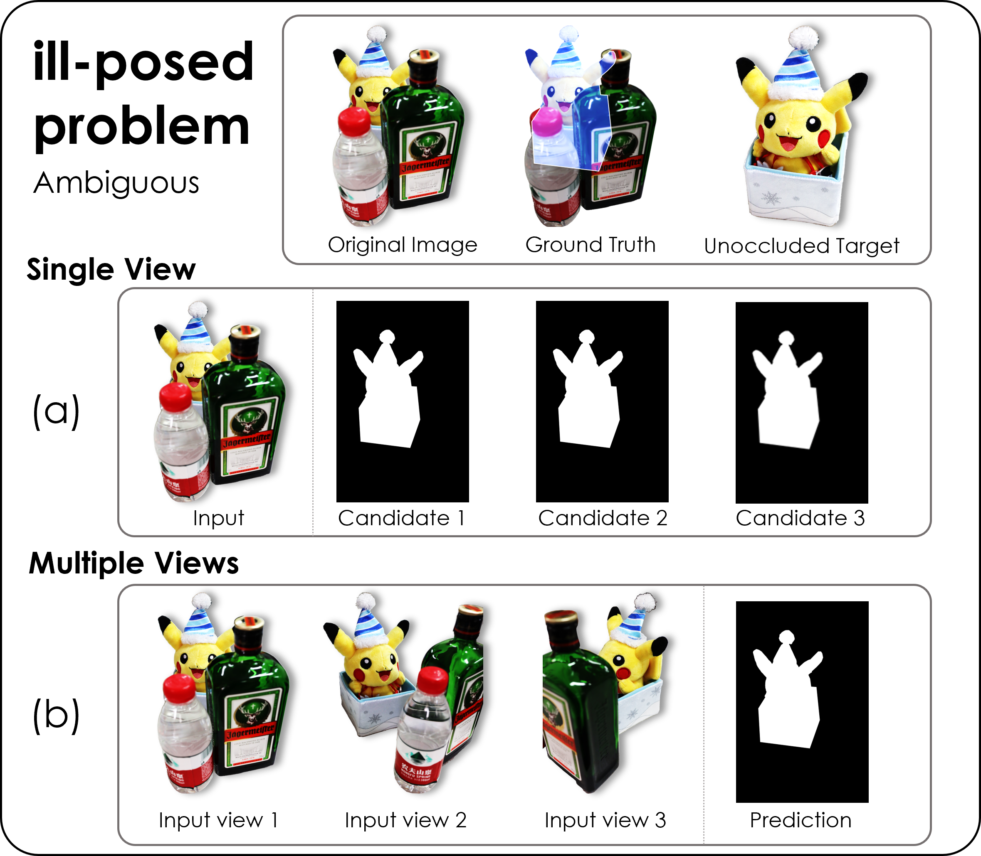
Notes:
2023_ICCV_MUVA

Slide 7
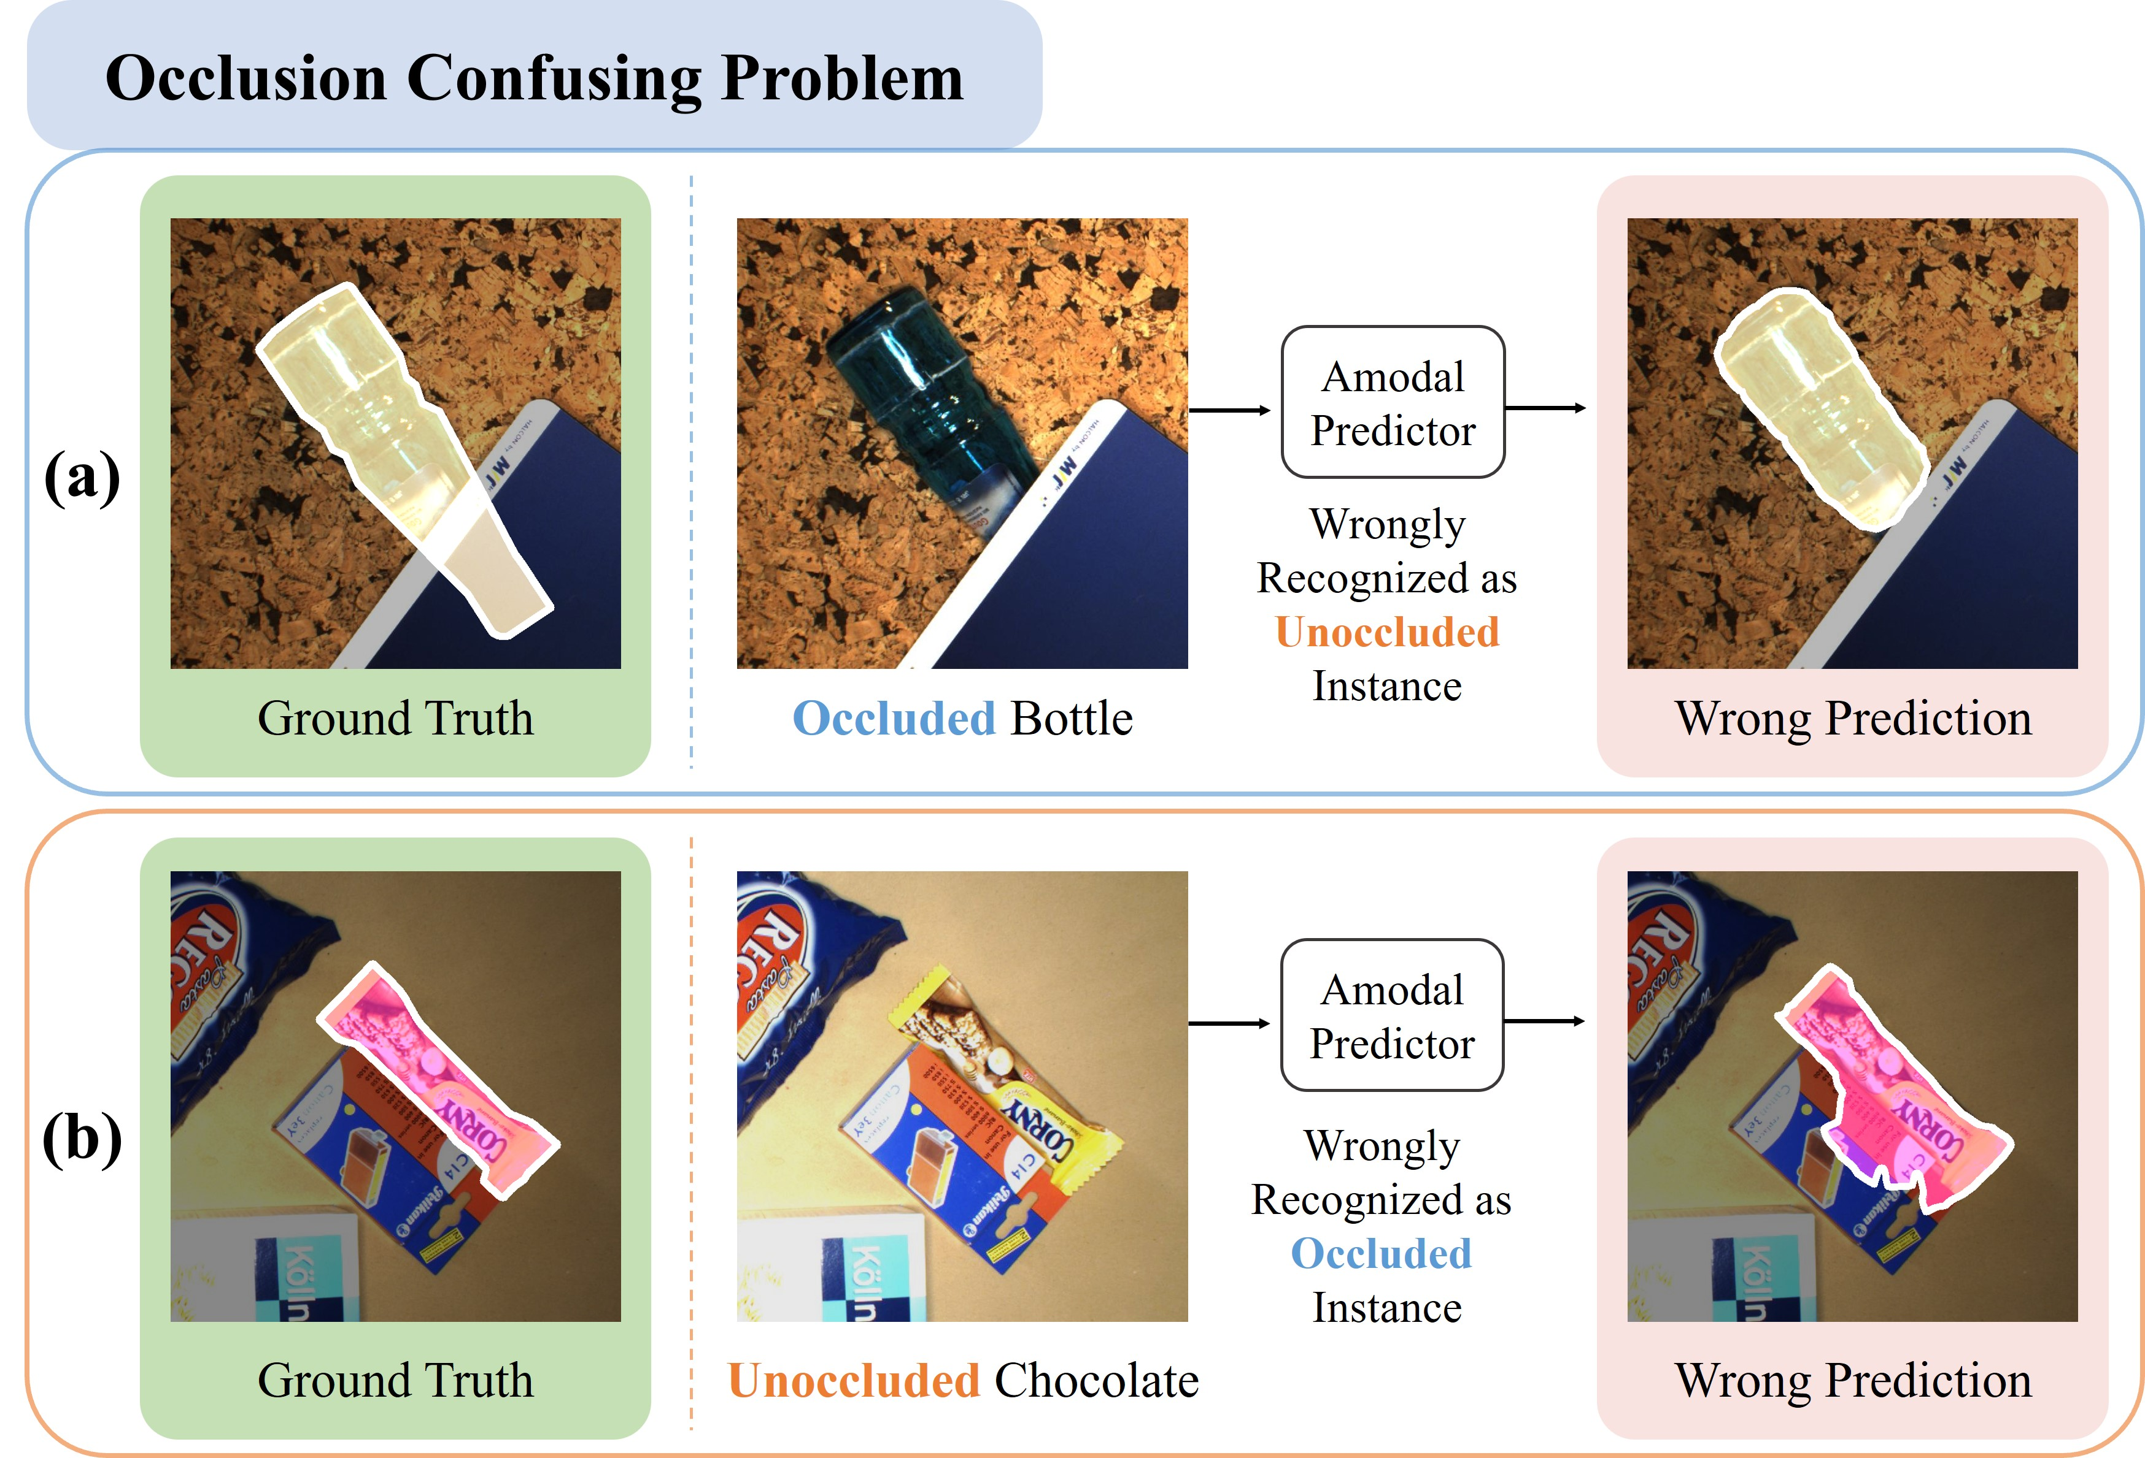
Notes:
2023_ICASSP_OAFormer

Slide 8
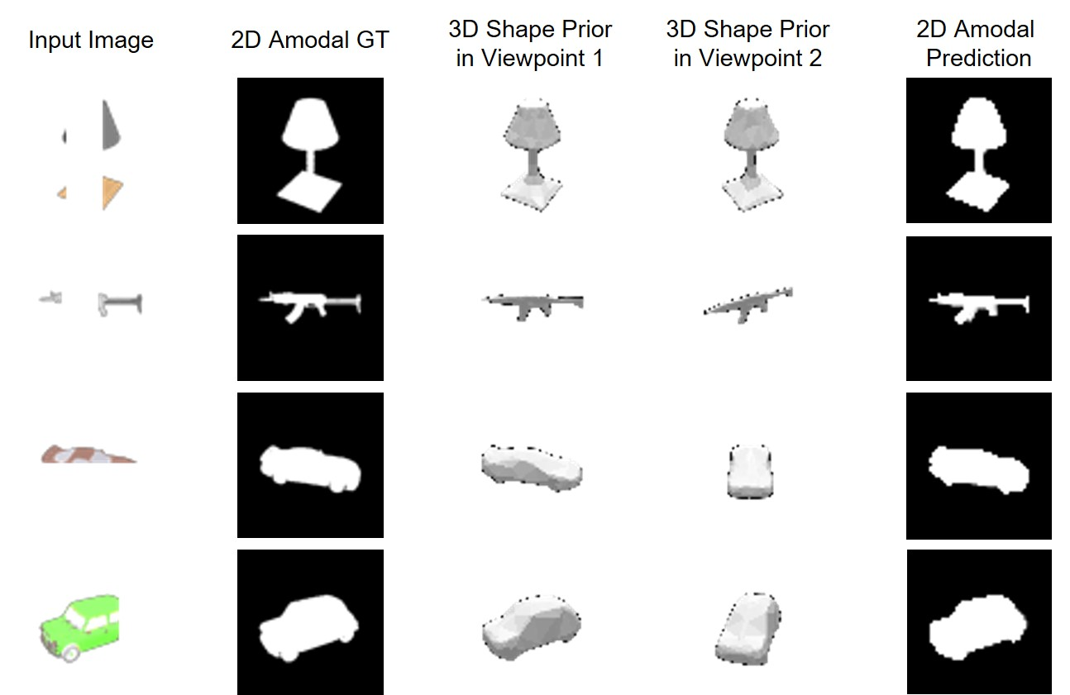
Notes:
2022_ECCV_A3D

Slide 9
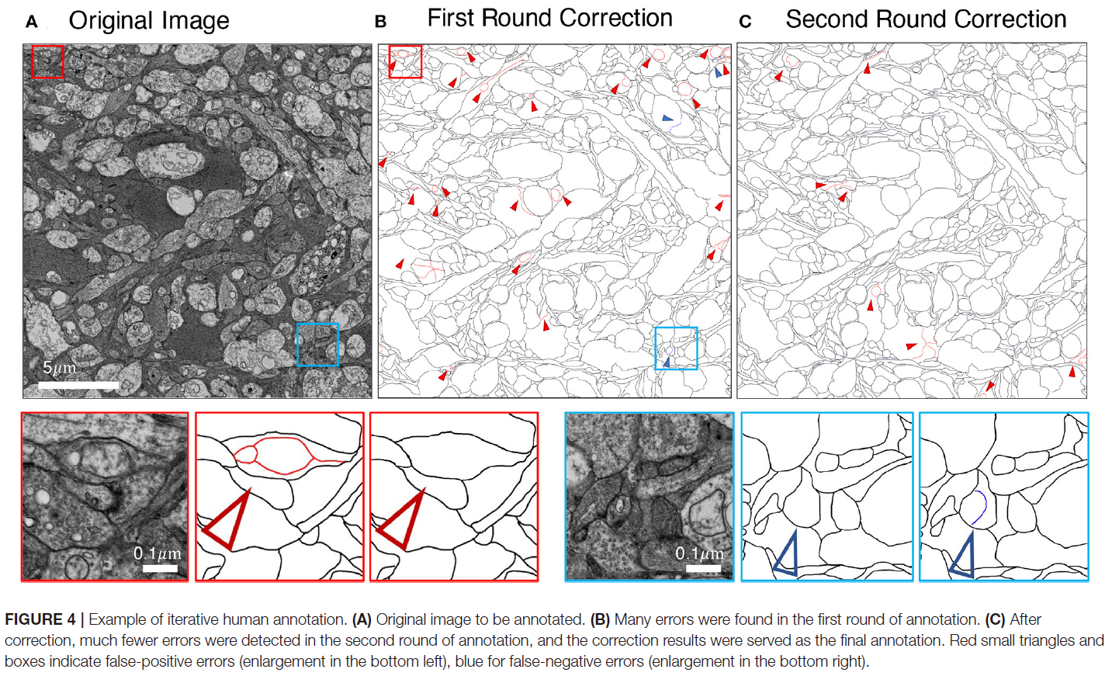
Notes:
2022_Frontiers

Slide 10
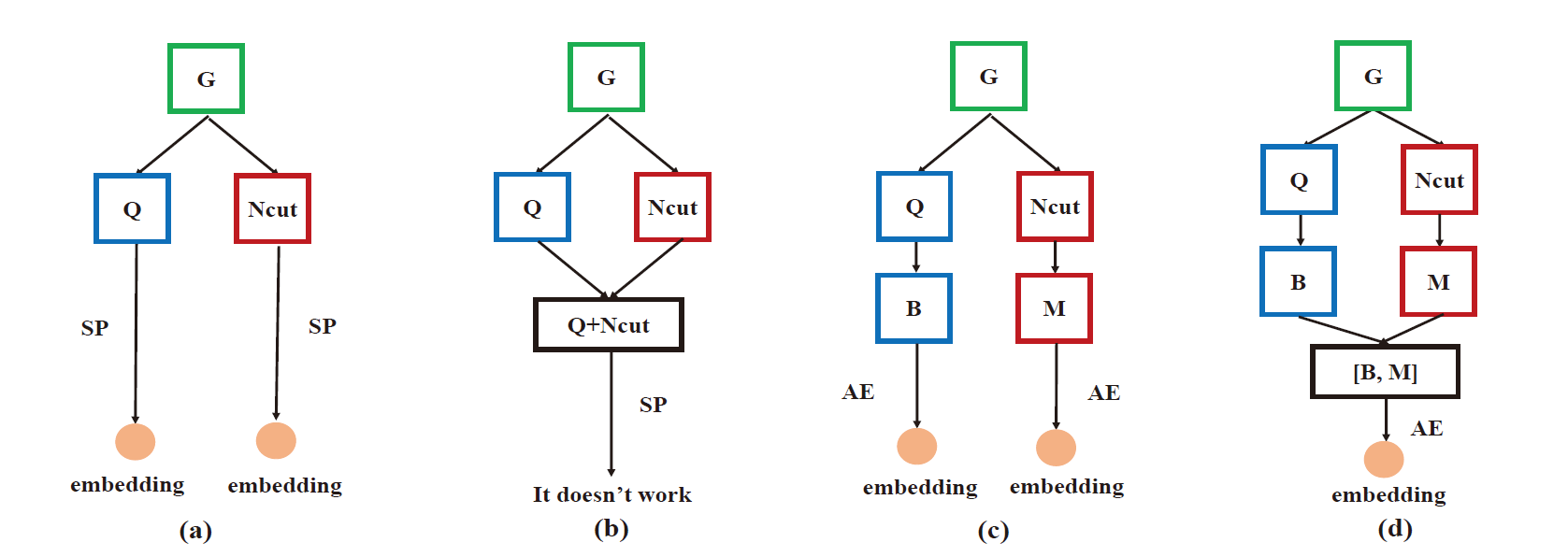
Notes:
2017_ICTAI

Slide 11
